Slide 1
ACCESSIBLE
web
CONTENT
wifi: LIBTU
Notes:
Good Afternoon
Thank for survey, wide level of understanding

Slide 2
Notes:
Director of Web & Creative Strategy for CCCC
Over 10 year in web
2 years accessibility

Slide 3
Notes:
It’s part of
Progressive Enhancement
Responsive Design
Universal Design
And it’s part of whatever popular buzzword you want to use (because it’s a large part of the Web).
It’s about making sure everyone can get to they content they want/need.

Slide 4
Notes:
In 1998, Congress amended the Rehabilitation Act of 1973 to require Federal agencies to make their electronic and information technology (EIT) accessible to people with disabilities
On February 18, 2015, the United States Access Board released a proposed rule updating the 508 Standards and the 255 Guidelines which is available for public comment until May 28.
We are responsible for our 3rd party software/services
1 (http://section508.gov/content/learn/laws-and-policies)
2 (http://www.access-board.gov/guidelines-and-standards/communications-and-it/about-the-ict-refresh)

Slide 5
Notes:
Web Content Accessibility Guidelines (WCAG) are part of a series of web accessibility guidelines published by the Web Accessibility Initiative (WAI) of the World Wide Web Consortium (W3C), the main international standards organization for the internet.
They consist of a set of guidelines for making content accessible, primarily for people with disabilities, but also for all user agents, including highly limited devices, such as mobile phones.
Today we are mostly going to focus on A and AA

Slide 6
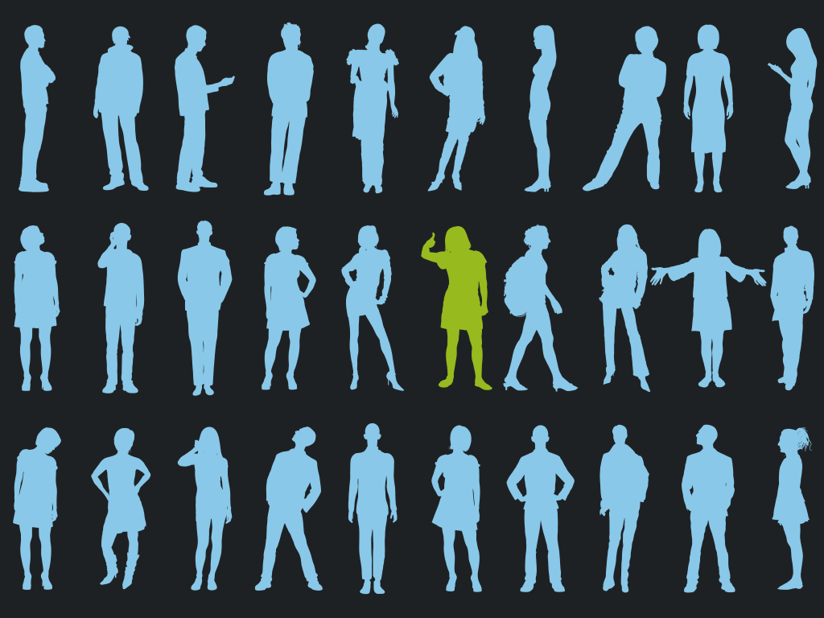
Notes:
Remember that people are diverse. Be careful not to assume that all users, including users with disabilities, use the product the same way.
People use different interaction techniques, different adaptive strategies, and different assistive technology configurations.
People have different experiences, different expectations, and different preferences.

Slide 7
1.
Page
Structure

Slide 8
Page Titles
<title>
Notes:
This is similar to a title on a book, without this you’d need to open every book before you could tell what book it was
Needs to be Meaningful & Accurate
“Helps people find content and orient themselves within it”

Slide 9
Style | Structure
Notes:
Separation of style and structure
In web
CSS
HTML
In documents (word, ppt, etc.) use styles as well
text
styles
Avoid using HTML elements in nonstandard ways
<ol> progression, sequence
<ul> no sequence
<ol>, <ul> should not just be used for creating an indent
HTML elements are used in specific way, for example
assistive technology can generate a list of links
PDF forms mode

Slide 10
Meaningful
Sequence
<h1>
<h2>
<h3>
<h4>
<h5>
Notes:
Meaningful sequence, so an alternative presentation of information preserves reading order
Use good headers
When headings are clear and descriptive, users can find the information they seek more easily, and they can understand the relationships between different parts of the content more easily. (also good for SEO)
Technically, header nesting isn’t part of WCAG, but good because it creates a hierarchy
Documents use headers as well to structure content

Slide 11
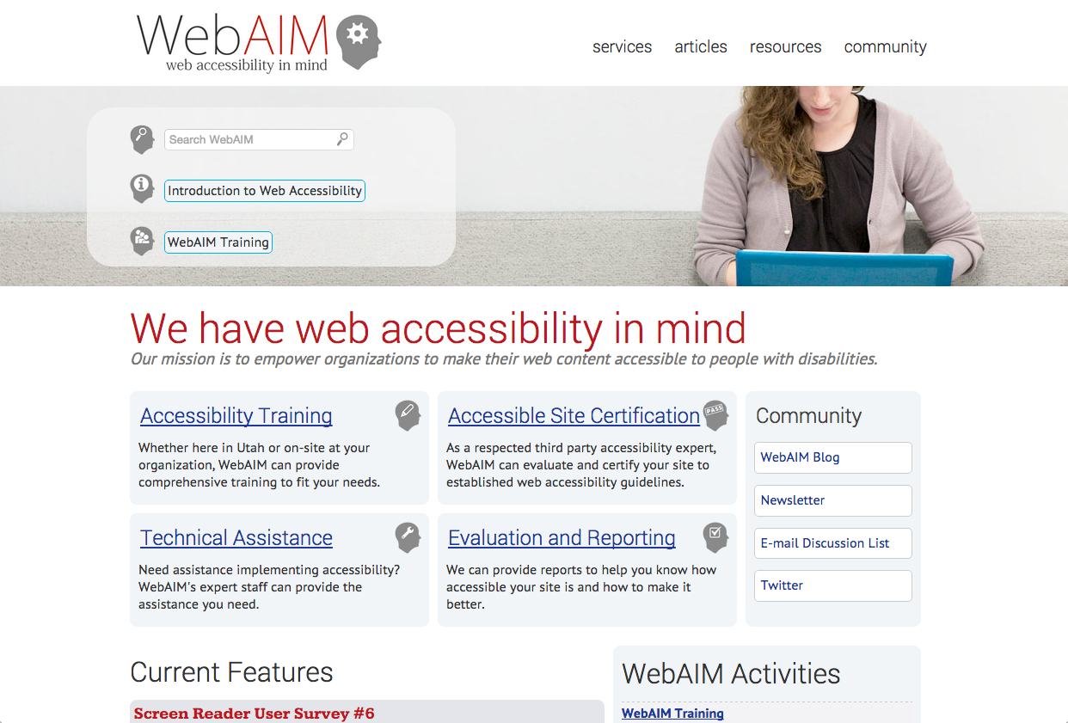
Skip
Repeated Content
Notes:
Example
Navigation (which needs to be consistent for low cognitive skills)
Header graphics
Advertising frames
WebAIM has a great version (WebAIM is non-profit organization based at the Center for Persons with Disabilities at Utah State University)

Slide 12
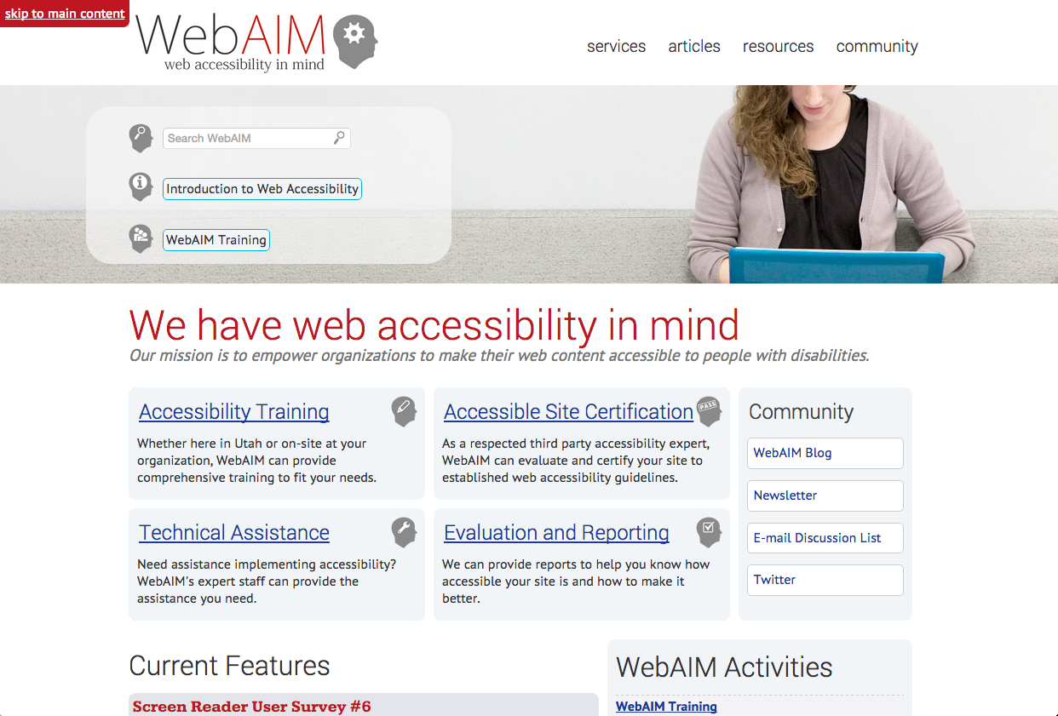
Skip
Repeated Content

Slide 13
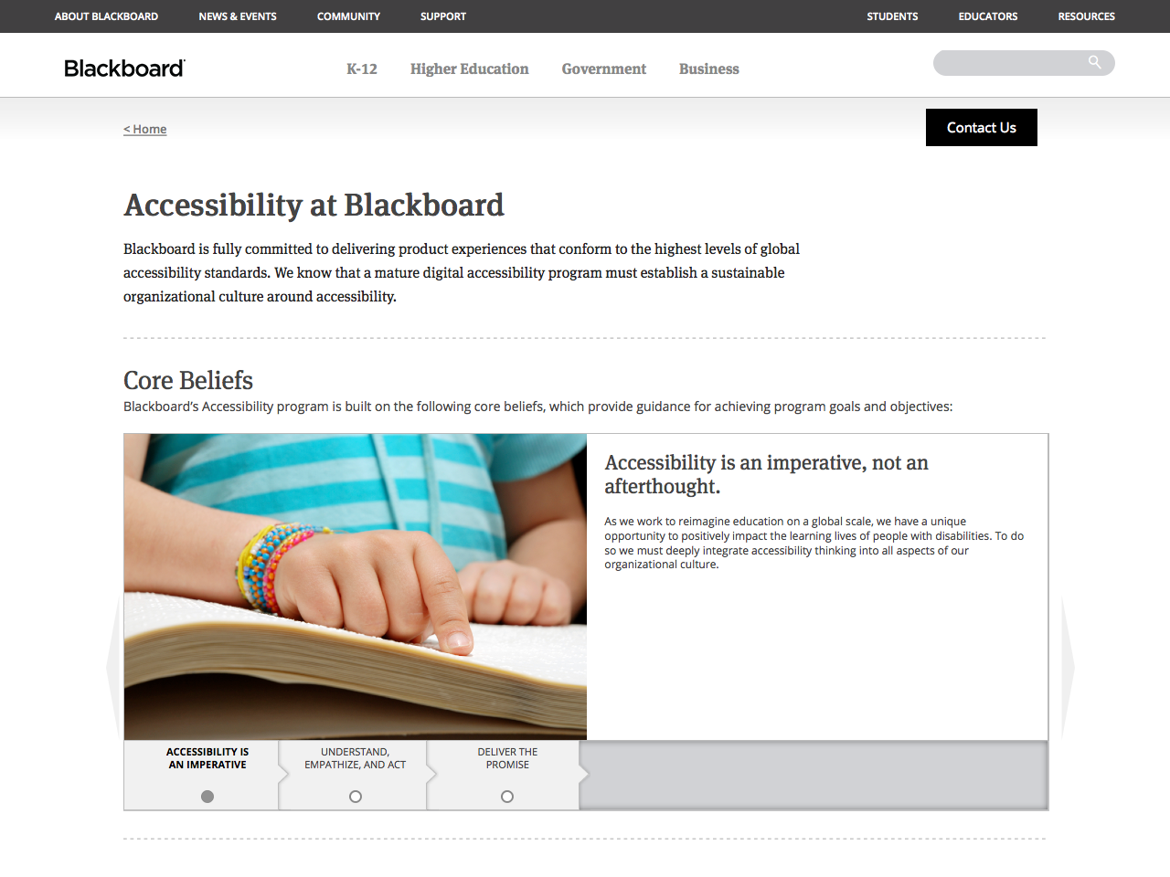
Build an
Accessibility Webpage
Notes:
Post mission/goals
List features of website
Skip Navigation w/ instructions on multiple versions (ie. Global and page)
List access keys
Definitions
Software links and details (ie. Adobe Acrobat)
MOST IMPORTANT Contact information for questions/help

Slide 14
2.
Content

Slide 15
Text is
RESIZABLE
Notes:
Text can be resized without assistive technology up to 200 percent without loss of content or functionality
Words could become to wide for horizontal space causing them to truncate
Text or images overlapping other content

Slide 16
Text is
READABLE
READABLE
Notes:
Use readable fonts, this should be obvious (header example)
Reading Level, lower secondary education level (under 9th grade). Sever obstacles for people with learning disabilities
You can provide supplement content if your reading level is above recommended
Basically use short common words and short sentences, work with an educator to evaluate the reading level

Slide 17
Is that
ENGLISH?
Notes:
Provide ‘definitions’ of unusual words through either a
Definition
Glossary (with link to)
Inline description
This will help folks with cognitive, language, and learning disabilities
Make sure abbreviations are spelled out

Slide 18
Define Language
<html lang=”en”>
<span lang=”en”>
<p lang=”es”>Hola</p>
Notes:
Assistive tech and conventional browsers can render text more accurately
Screen readers can load correct pronunciation rules
Media players can render captions correctly
Keep this bottom line in mind when adding text into your CMSs

Slide 19
Notes:
Text and images of text have a contrast ratio of at least 4.5:1
Except
Large scale (18 pt text or 14 pt & bold, min 3:1)
Decorative text
Logo text
CMSs can ship with templates that do not meet these requirements

Slide 20
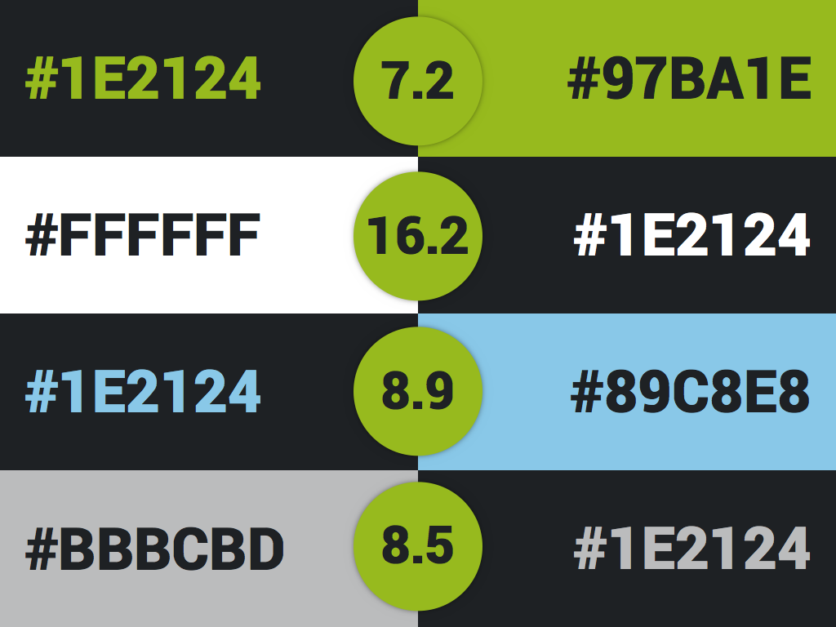
Notes:
Here are the colors I’m using in this presentation and there contrast ratio
Use tools to check your color ratios, eye and environments and play tricks on you

Slide 21
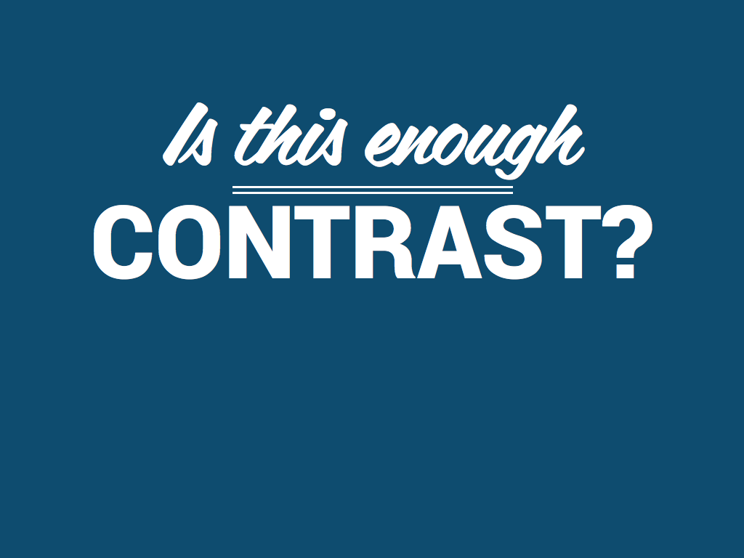
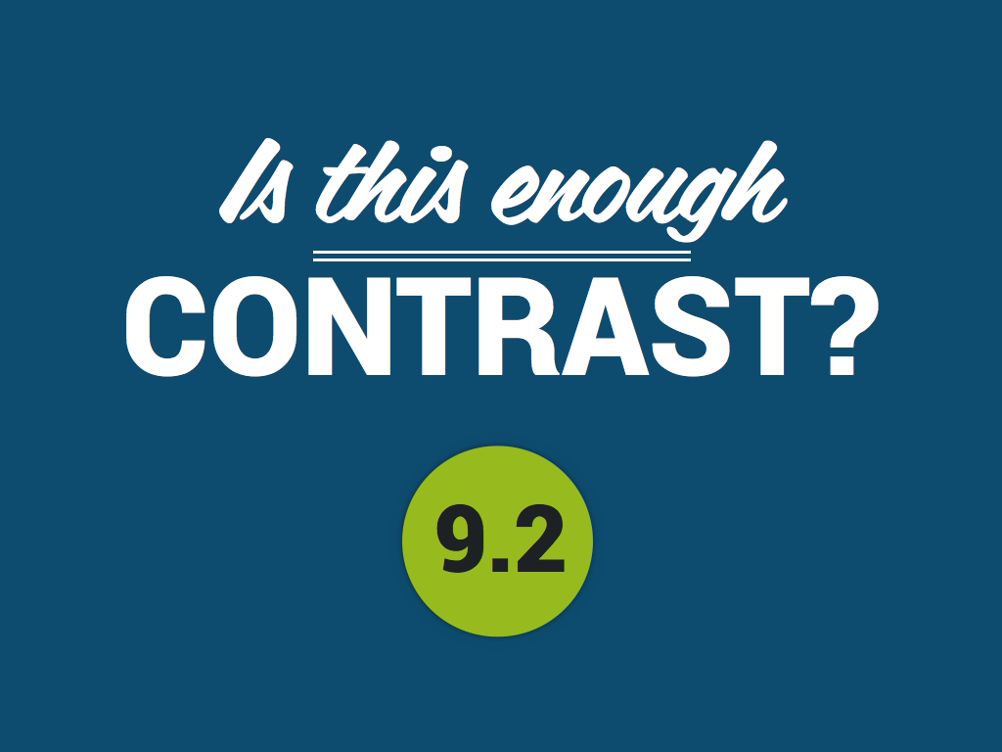
Notes:
Let’s try a little test…
YES

Slide 22
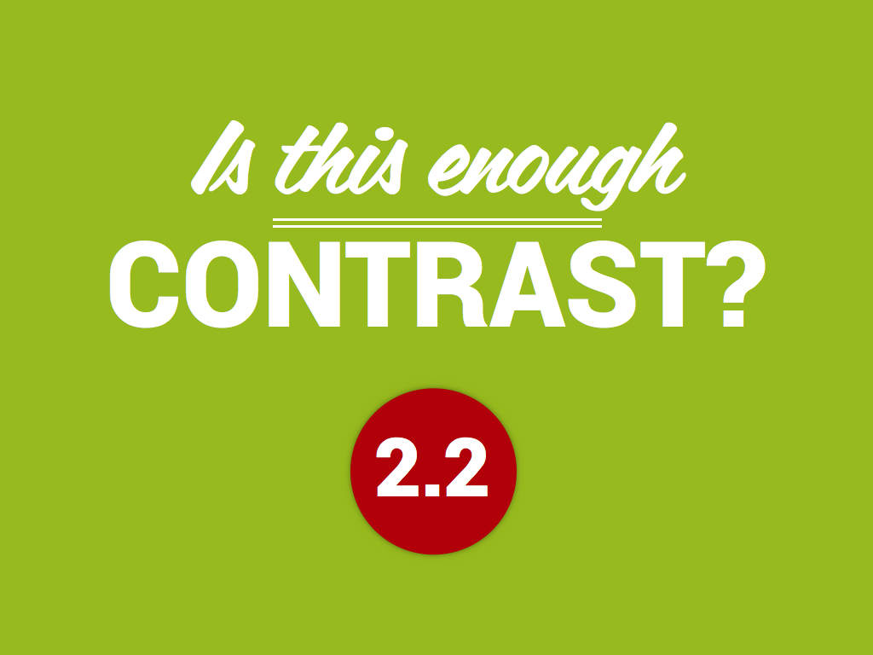
Notes:
NO

Slide 23
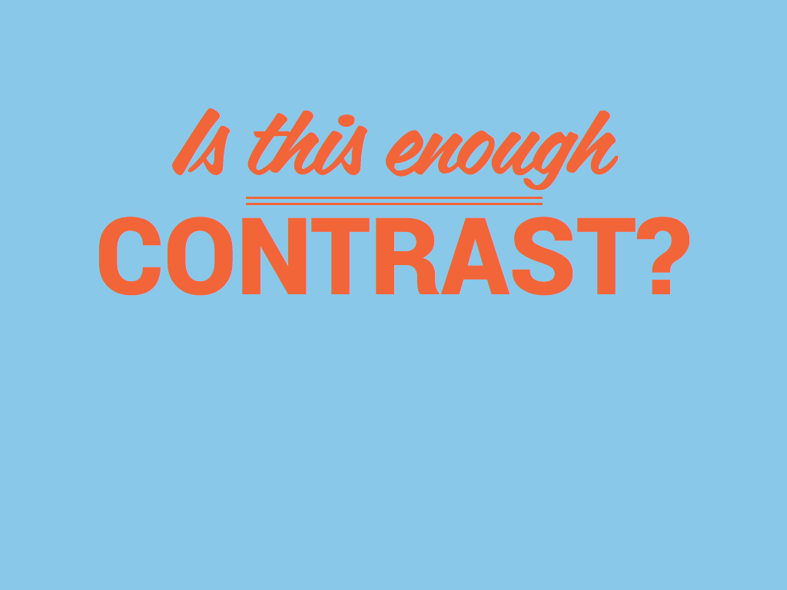
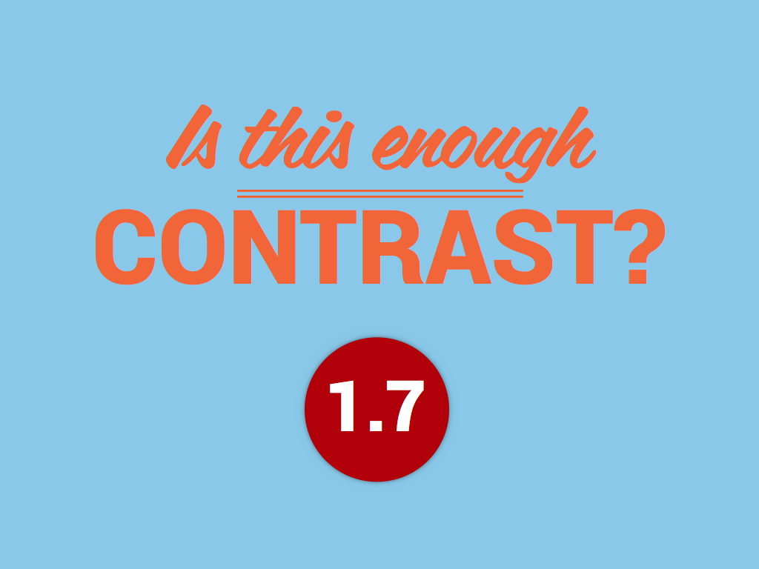
Notes:
NO

Slide 24
Monochromacy (no cones)
Notes:
Click the red button above to sign up!?
Color blind: Monochromacy (no cones)

Slide 25
Protanopia (red-green; no red cones)
Notes:
OK, click the red button now
Color blind: Protanopia (red-green; no red cones)

Slide 26
Deuteranopia (red-green; no green cones)
Notes:
How about now?
Also, keep in mind i’m using color, but this also includes images
Click the arrow below
Deuteranopia (red-green; no green cones)

Slide 27
Without Impairment
Notes:
All same set of buttons
10% of men experience some level of color blindness

Slide 28
CLICK HERE
Notes:
How many of us use links that say, “Click Here”?
Links should make sense out of context.

Slide 29
MORE
Notes:
Or how about, “More” or “Read More”?
Links should make sense out of context.
Most screen readers say "link" before each link.

Slide 30
You Must Complete a
BOOK REQUEST
Notes:
You Must Complete a “Book Request” where book request is a link
It’s good practice to reserve underlines for links only
If you’re doing a document
Screen reader users often navigate from link to link, skipping the text in between, tabbing from link to link is a way of skimming web content, especially if users are trying to find a particular section of a web site.

Slide 31
You Must Complete a
BOOK REQUEST
Notes:
Visually indicate with receives focus, like a hover or when tabbed to
Roll over

Slide 32
BOOK REQUEST
Notes:
Icon + text = all one link

Slide 33
You Must Complete a
BOOK REQUEST
(opens in a new window)
Notes:
Make sure you tell the user if the context of the site will change (ie. opens in a new window)
Place the distinguishing information of links at the beginning of a link.
Don't put extra information first.

Slide 34
3.
images

Slide 35
TEXT
NO
in
IMAGES
Notes:
Don’t use images of text
Make sure any text in images of text is at least 14 points and has good contrast
Really important in word docs

Slide 36
EVERY Image
must have
‘alt’ TAG
Notes:
But not every alt tag must have text
Decorative images don’t need text

Slide 37
<img alt=“smiling student”>
Notes:
Not good
But not every alt tag must have text
Decorative images don’t need text
alt tags should be meaningful and express what the picture “says”

Slide 38
<img alt=“logo”>
Notes:
Not good

Slide 39
<img alt=“Central Carolina Community College”>
Notes:
Good

Slide 40
<a href=“”>
</a>
<img alt=“house”>
<img alt=“homepage”>
Notes:
Standard context, picture of house in link takes you home
Is this a good alt tag?
No, alt tags inside links should explain where the link will lead.

Slide 41
BOOK REQUEST
Notes:
Quiz, from before
What alt tag would you use on this?
Answer: none

Slide 42
Charging the phone: Connect the phone to a power outlet using the cable and power adaptor provided.
source: WAI Quick Start Guide, http://w3c.github.io/wai-quick-start/writing.html
Notes:
What would be a good alt tag?
NO - “Charging Phone”
YES - “Plug cable into the bottom edge of the phone to charge”
Same photo > different pages > different alt tags

Slide 43
4.
FORMS

Slide 44
Labels
<label for="username">Username</label>
<input type="text" id=“username" />
Notes:
Labels are the instructions that identify the controls
They let users know what data is expected
When an input is selected screen readers speak the label

Slide 45
Name
<label for="name">Name</label>
<input type="text" id=“name" />
Notes:
Here’s another example
In a CMS you should see the option to add a label

Slide 46
Phone:
(
)
-
Notes:
How many labels does this have?

Slide 47
Phone:
(
)
-
<fieldset>
<legend>Phone:</legend>
<label for=“areacode">Area Code</label> <input type="text" id=“areacode" />
<label for=“exchange">Exchange</label> <input type="text" id=“exchange" />
<label for=“number">Number</label> <input type="text" id=“number" />
</fieldset>
Notes:
<fieldset> is used to group several controls and their labels
<legend> acts as a caption for the group that has been created
Each control (<input>) gets it’s own label
These labels can be hidden with CSS

Slide 48
Phone:
1
(
)
-
2
3
4
<fieldset>
<legend>Phone:</legend>
<label for=“areacode">Area Code</label> <input type="text" id=“areacode" />
<label for=“exchange">Exchange</label> <input type="text" id=“exchange" />
<label for=“number">Number</label> <input type="text" id=“number" />
</fieldset>
1
2
3
4
Notes:
PDFs, problem
<fieldset> is used to group several controls and their labels
<legend> acts as a caption for the group that has been created
Each control (<input>) gets it’s own label
These labels can be hidden with CSS, or you could turn the phone field into one input and use progressive enhancement to format it

Slide 49
*
Name
*
Name
Notes:
Focus is visible
When a form element receives focus it changes to visibly to indicate
When driving the site with a keyboard this is helpful to determine location
Indicate Required

Slide 50
x
An error has occurred: Your ‘email’ is formatted incorrectly
Notes:
Use multiple cues as to error
Color
Icon
Highlight Field w/ error
Sounds (remember not to rely on this)
When the form is redisplayed, make sure that the inputed user data is still there

Slide 51
5.
Audio, Video, Multimedia

Slide 52
Timing
Notes:
Anything with timing:
Slideshow
Carousel
Movie
Test
At least one of the following is true:
Turn off: The user is allowed to turn off the time limit before encountering it
Adjust: The user is allowed to adjust the time limit before encountering it over a wide range that is at least ten times the length of the default setting
Extend: The user is warned before time expires and given at least 20 seconds to extend the time limit with a simple action (for example, "press the space bar"), and the user is allowed to extend the time limit at least ten times
Real-time Exception: The time limit is a required part of a real-time event (for example, an auction), and no alternative to the time limit is possible
Essential Exception: The time limit is essential and extending it would invalidate the activity
20 Hour Exception: The time limit is longer than 20 hours

Slide 53
Audio
Notes:
For audio that plays more then 3 seconds, must have
Pause
Stop
Turn down independent of system
If your site has music that is blaring how can a user hear the screen reader?
Highly encouraged, if music on site the first element on page should be off button (before menu, logo, etc.)

Slide 54
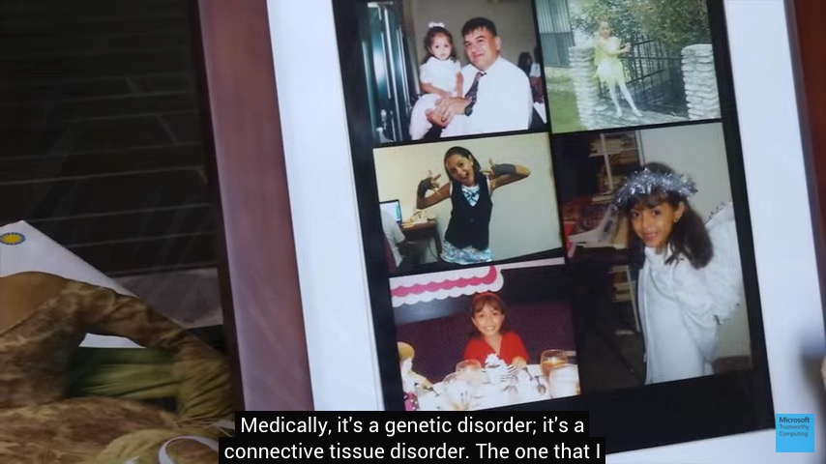
Text Alternative
Notes:
Audio & Video provide text alternative
Transcript - ids speaker, verbatim record of dialogue, significant sounds (laughter, applause, etc.)
Captions - ids speaker, verbatim record of dialogue, significant sounds (laughter, applause, etc.)
Captions also help with:
Non-native speakers
Unfamiliar with dialect
Audio is unavailable, like library computers where speakers are disabled
Prioritize:
Focus on NEW projects
Question the importance of NEW media
Use tools and services (partner with other departments)
Remove old or non-useful videos

Slide 55
Flashing
Text
Notes:
Content shouldn’t flash more than 3 times in any one second period
There are a couple minor exceptions at the single ‘A’ level, but I believe this is the best rule to follow

Slide 56
Helpful Tools
mrmorgansteele.com/2015PRIMA

Slide 57
Thank You
@MrMorganSteele
msteele@cccc.edu
mrmorgansteele.com/2015PRIMA
Notes:
Thank You

